Slide 1
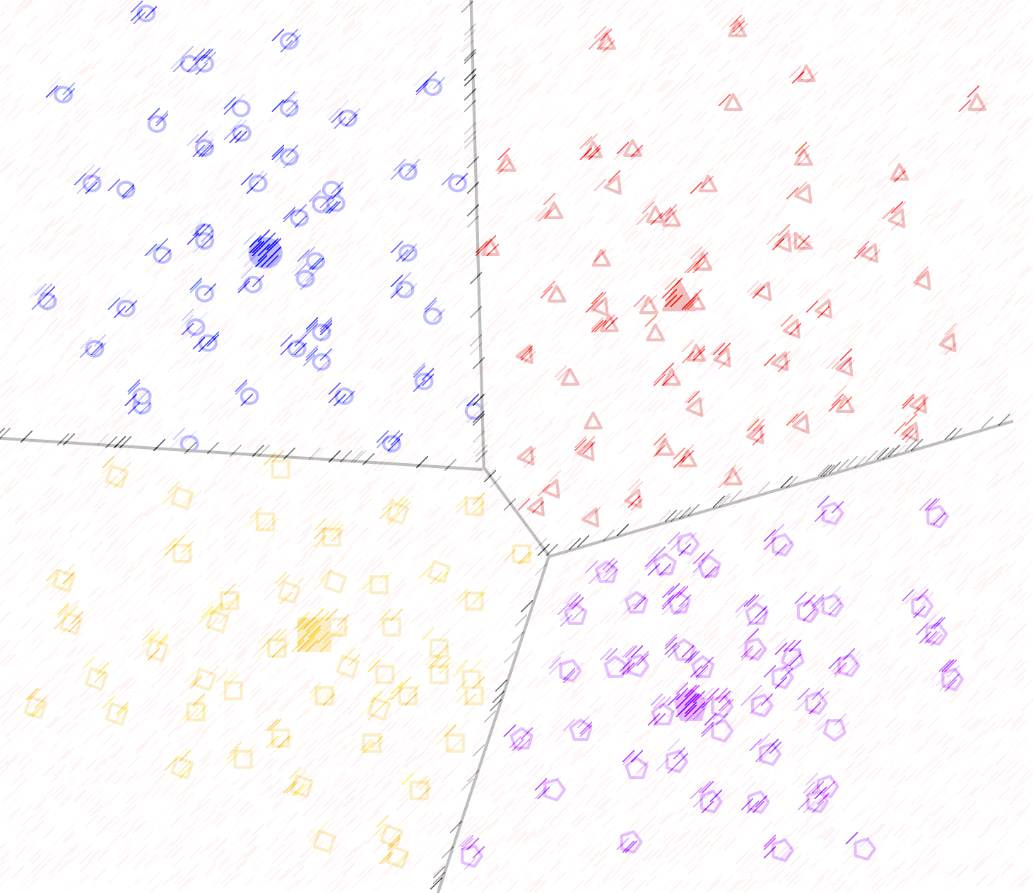

Lecture 5: Clustering Algorithms (Part I)
CSE445 Machine Learning
Dr. Jilan Samiuddin (JSA)
Assistant Professor
North South University

Slide 2
Introduction
Goal: Group unlabeled data points into "clusters" based on similarity
Key Idea: Objects in the same cluster are more alike (high intra-cluster similarity) than those in different clusters (low inter-cluster similarity)
Unsupervised: No predefined labels; algorithms infer structure from data alone
NOTE: It is not necessary that clusters formed must be circular in shape
Example usages:
Customer Segmentation: Group users by behavior for targeted marketing
Image Recognition: Segment pixels into objects/regions
Biology: Classify species/genetic patterns
Recommendation Systems: Cluster similar users/products

Slide 3
Types of Clustering
Hard Clustering (Exclusive Clustering)
Each data point belongs to exactly one cluster with no ambiguity
Example: If 4 data points are clustered into 2 groups, every point is assigned to either Cluster 1 or Cluster 2, never both
Algorithms: K-Means, Hierarchical Clustering
Soft Clustering (Probabilistic Clustering)
Data points can belong to multiple clusters with varying probabilities
Instead of strict assignments, the algorithm computes the likelihood of a point being in each cluster
Example: For 4 data points and 2 clusters, a point may have a 70% chance of being in Cluster 1 and 30% in Cluster 2
Algorithms: Gaussian Mixture Models (GMM), Fuzzy C-Means
Key Difference: Hard clustering forces rigid boundaries, while soft clustering allows for uncertainty and overlapping memberships

Slide 4
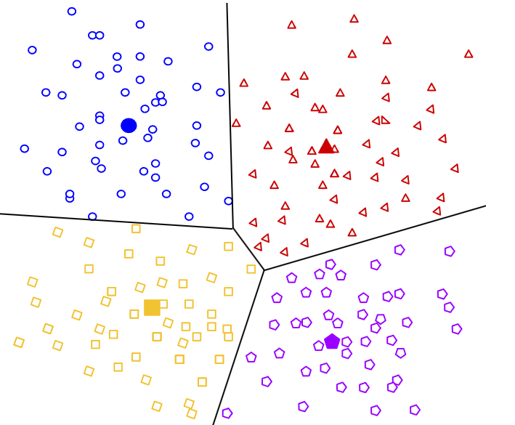
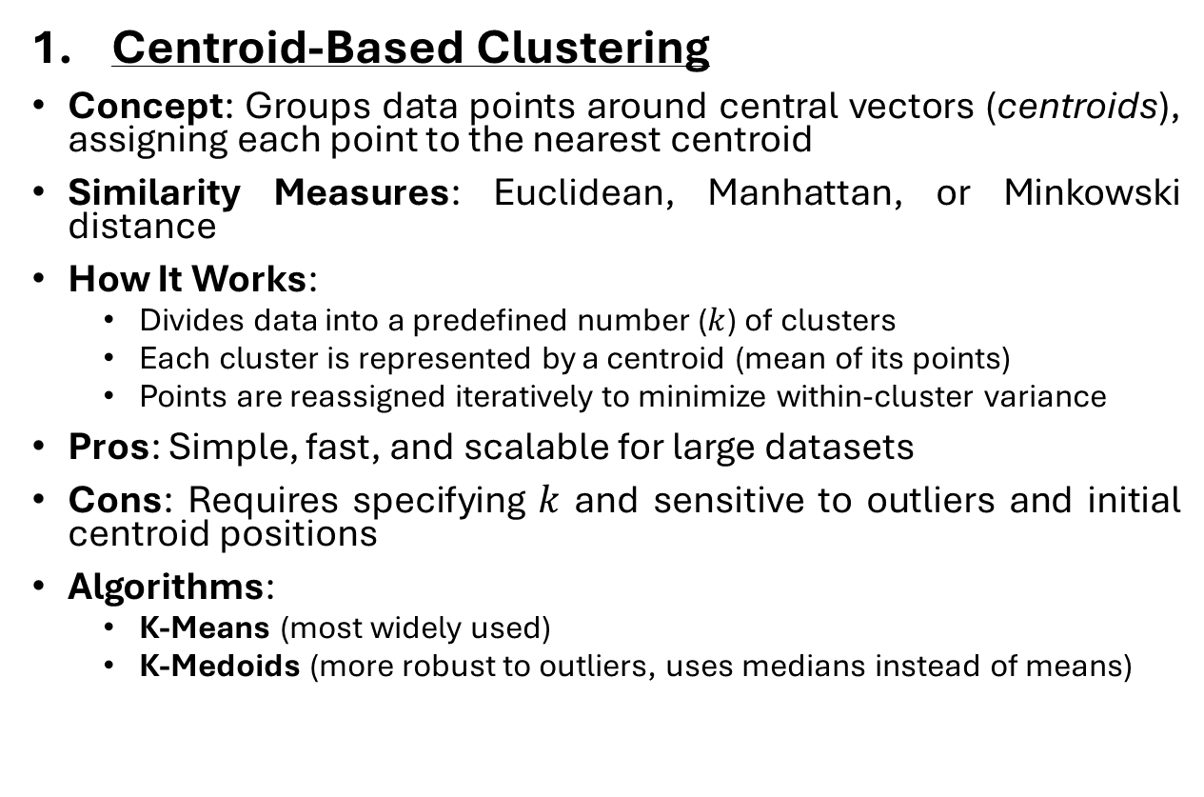
Types of Clustering Methods
Centroid-Based Clustering
Concept: Groups data points around central vectors (centroids), assigning each point to the nearest centroid
Similarity Measures: Euclidean, Manhattan, or Minkowski distance
How It Works:
Divides data into a predefined number ($k$) of clusters
Each cluster is represented by a centroid (mean of its points)
Points are reassigned iteratively to minimize within-cluster variance
Pros: Simple, fast, and scalable for large datasets
Cons: Requires specifying $k$ and sensitive to outliers and initial centroid positions
Algorithms:
K-Means (most widely used)
K-Medoids (more robust to outliers, uses medians instead of means)
Image credit: Google

Slide 5
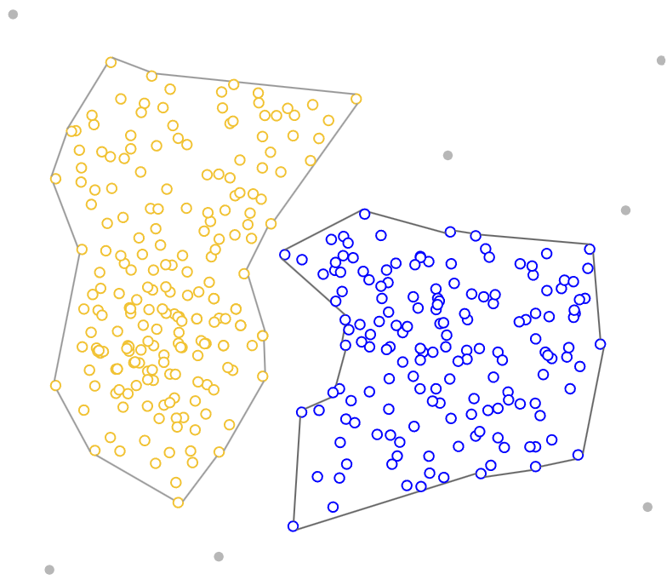
Types of Clustering Methods
Density-Based Clustering
Concept: Identifies clusters as dense regions separated by sparse areas; handles noise and arbitrary shapes
Key Features:
Automatically detects the number of clusters
Robust to outliers and varying cluster shapes/sizes
Works well with irregular or overlapping clusters
How It Works:
Expands clusters from core points with sufficient nearby neighbors
Outliers are not assigned to any clusters
Algorithms:
DBSCAN (Density-Based Spatial Clustering of Applications with Noise)
OPTICS (Ordering Points To Identify Clustering Structure)
Image credit: Google

Slide 6
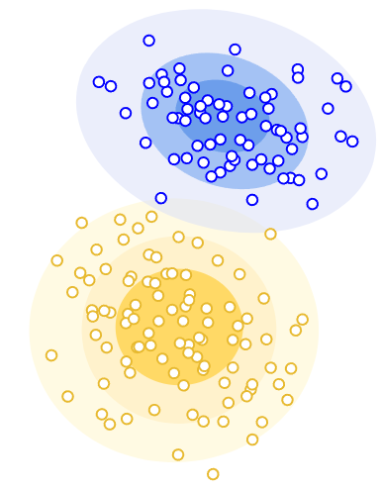
Types of Clustering Methods
Distribution-Based Clustering (Probabilistic Methods)
Concept: Assumes data is generated from statistical distributions (e.g., Gaussian)
How It Works:
Estimates distribution parameters (mean, variance) for each cluster
Assigns points based on probability (e.g., likelihood of belonging to a Gaussian)
Pros: Captures clusters of varying shapes/sizes; handles uncertainty
Cons: Requires assumptions about data distribution
Algorithm: Gaussian Mixture Models (GMM)
Image credit: Google

Slide 7
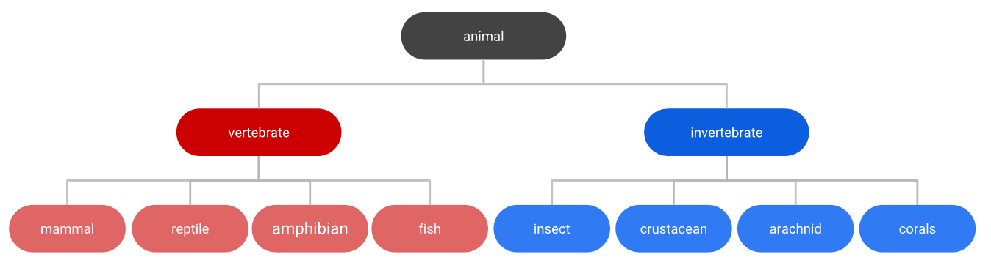
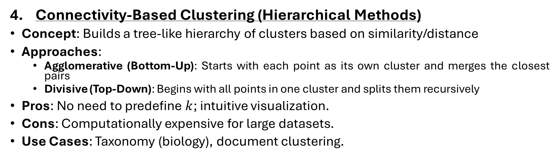
Types of Clustering Methods
Connectivity-Based Clustering (Hierarchical Methods)
Concept: Builds a tree-like hierarchy of clusters based on similarity/distance
Approaches:
Agglomerative (Bottom-Up): Starts with each point as its own cluster and merges the closest pairs
Divisive (Top-Down): Begins with all points in one cluster and splits them recursively
Pros: No need to predefine $k$; intuitive visualization.
Cons: Computationally expensive for large datasets.
Use Cases: Taxonomy (biology), document clustering.
Image credit: Google

Slide 8
K-means Algorithm

Slide 9
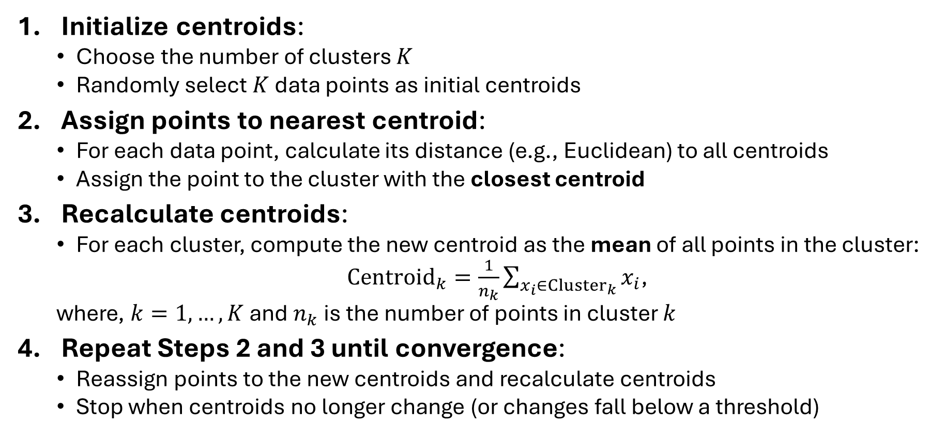
K-means Algorithm: Steps
Initialize centroids:
Choose the number of clusters $K$
Randomly select $K$ data points as initial centroids
Assign points to nearest centroid:
For each data point, calculate its distance (e.g., Euclidean) to all centroids
Assign the point to the cluster with the closest centroid
Recalculate centroids:
For each cluster, compute the new centroid as the mean of all points in the cluster:
$Centroid_{k}=\frac{1}{n_{k}}\sum_{x_{i}∈Cluster_{k}}{x_{i}}$,
where, $k=1,…,K$ and $n_{k}$ is the number of points in cluster $k$
Repeat Steps 2 and 3 until convergence:
Reassign points to the new centroids and recalculate centroids
Stop when centroids no longer change (or changes fall below a threshold)

Slide 10
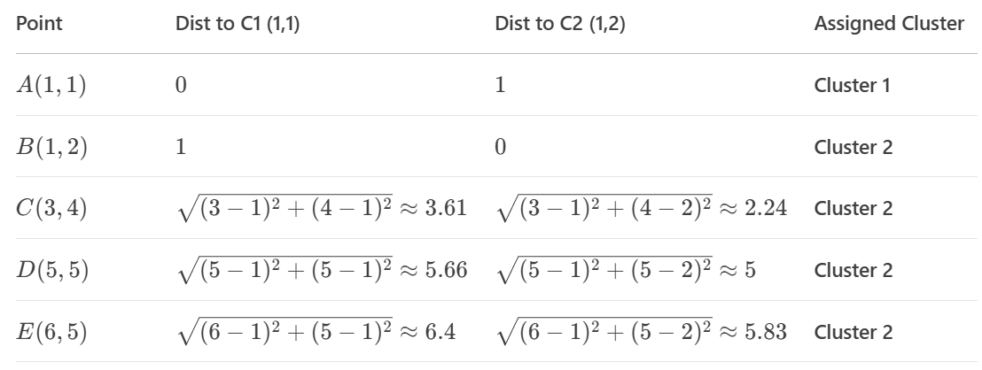
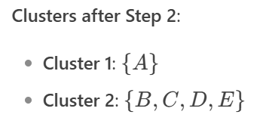
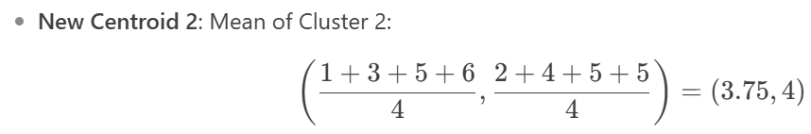

K-means Algorithm: Example
Dataset: $A\left(1,1\right), B\left(1,2\right), C\left(3,4\right), D\left(5,5\right), E(6,5)$
Initialize centroids:
$K=2$, select $C_{1}=A(1,1)$ and $C_{2}=B\left(1,2\right)$ randomly as initial centroids
Assign points to nearest centroid:
Recalculate centroids:

Slide 11
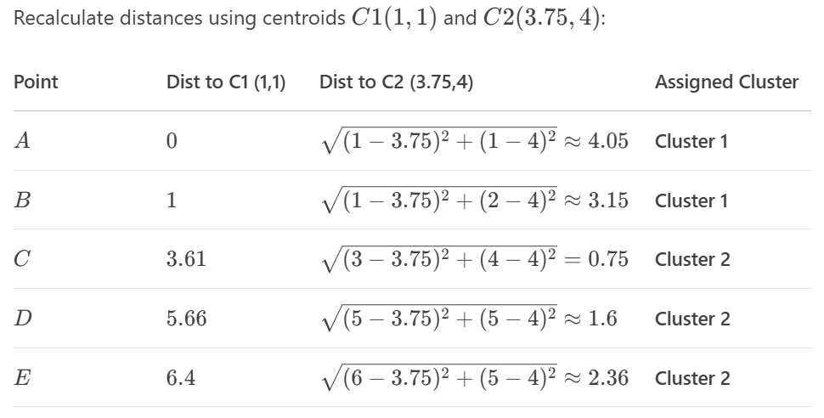
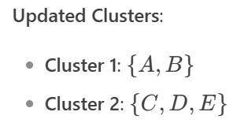

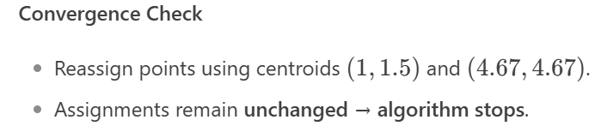

K-means example (contd.)
Dataset: $A\left(1,1\right), B\left(1,2\right), C\left(3,4\right), D\left(5,5\right), E(6,5)$
Repeat Steps 2 and 3 until convergence:

Slide 12
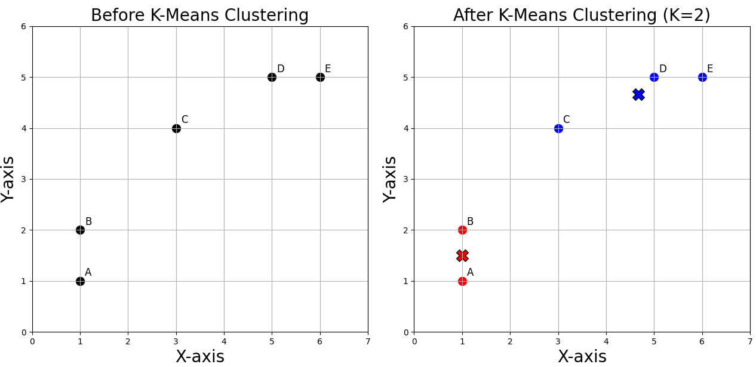

K-means example (contd.)
Dataset: $A\left(1,1\right), B\left(1,2\right), C\left(3,4\right), D\left(5,5\right), E(6,5)$

Slide 13
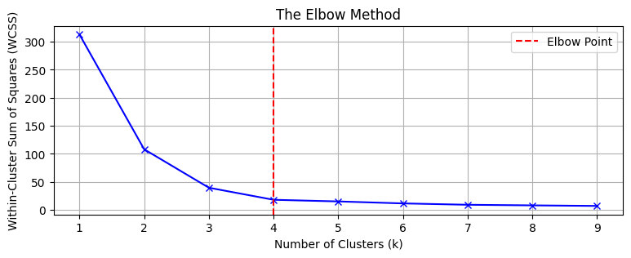


Elbow Method for Optimal $K$ in K-Means
The Elbow Method is a technique to determine the optimal number of clusters $K$ by identifying the point where the rate of decrease in within-cluster sum of squares (WCSS, also known as inertia) sharply changes. This "elbow point" represents the trade-off between model complexity and explanatory power.
There comes a point, i.e., the elbow point, where adding more clusters results in only a marginal decrease in WCSS
Image credit: GeeksForGeeks

Slide 14
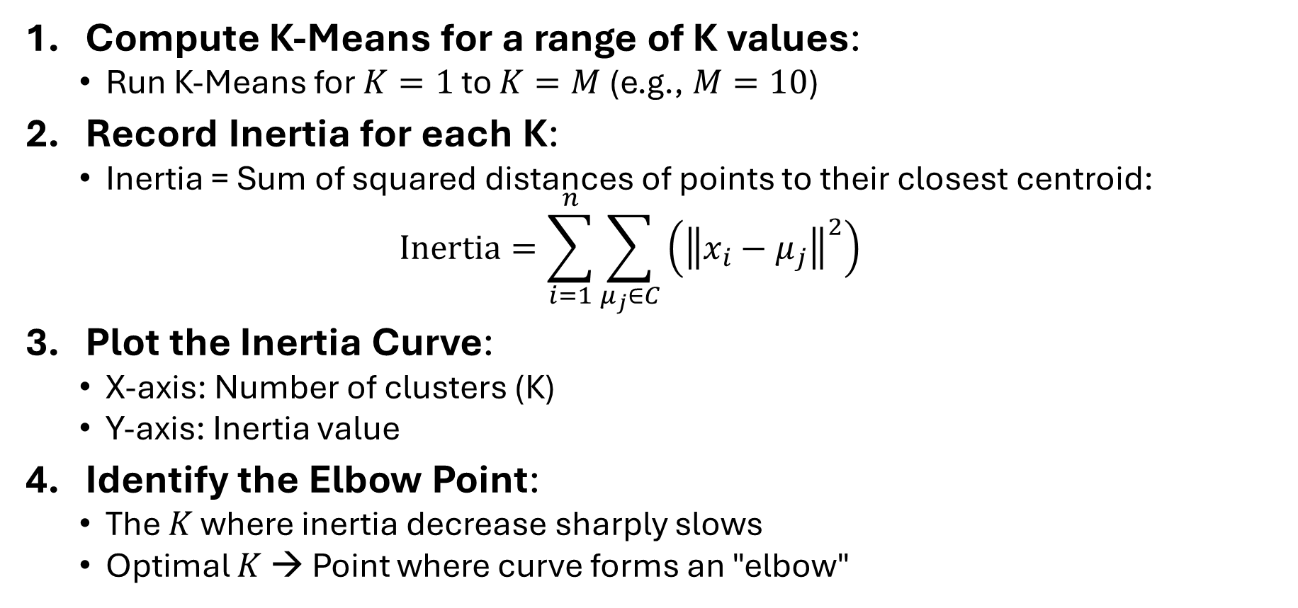
Elbow Method: Steps
Compute K-Means for a range of K values:
Run K-Means for $K=1$ to $K=M$(e.g., $M=10$)
Record Inertia for each K:
Inertia = Sum of squared distances of points to their closest centroid:
$$Inertia=\sum_{i=1}^{n}{\sum_{μ_{j}∈C}{\left({\left\|x_{i}−μ_{j}\right\|}^{2}\right)}}$$
Plot the Inertia Curve:
X-axis: Number of clusters (K)
Y-axis: Inertia value
Identify the Elbow Point:
The $K$ where inertia decrease sharply slows
Optimal $K$ → Point where curve forms an "elbow"

Slide 15
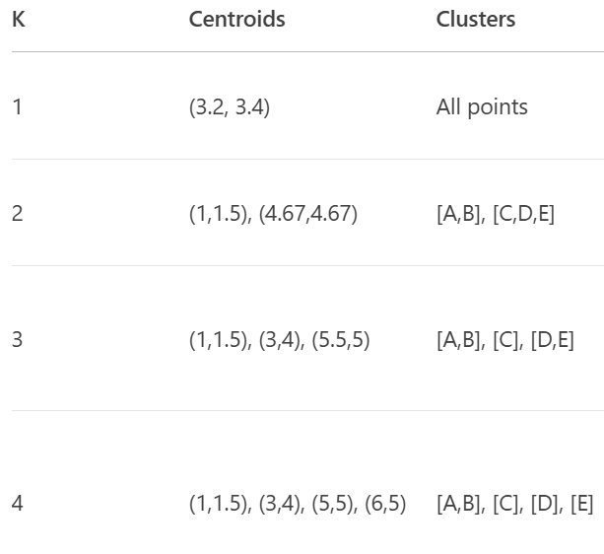
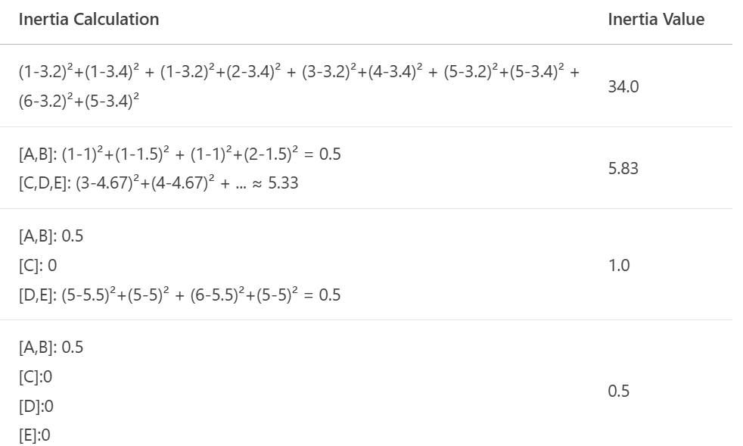
Elbow Method: Example
Dataset: $A\left(1,1\right), B\left(1,2\right), C\left(3,4\right), D\left(5,5\right), E(6,5)$
Step 1
Step 2

Slide 16
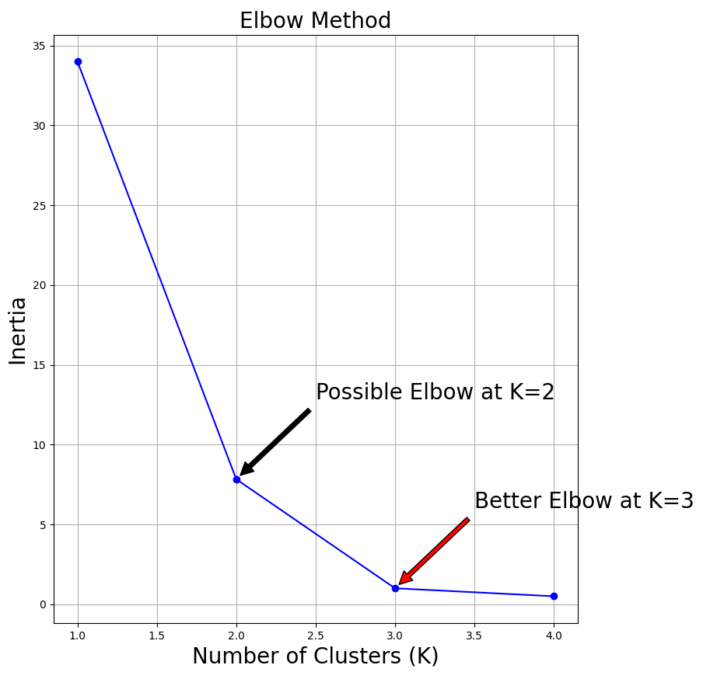
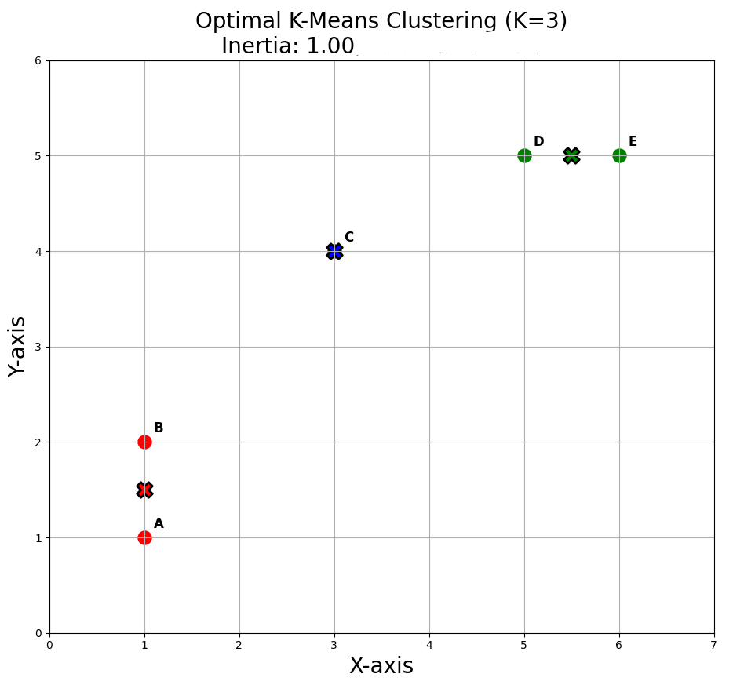
Elbow Method: Example (contd.)
Steps 3 and 4

Slide 17
Density-Based Spatial Clustering of Applications with Noise (DBSCAN)

Slide 18
Key Concepts
DBSCAN groups points in dense regions while identifying outliers in sparse areas. Unlike centroid-based methods, it discovers clusters of arbitrary shapes and is robust to noise
Key Terms:
ε (eps): Radius defining neighborhood around a point
MinPts: Minimum points required in ε-neighborhood to form dense region
Core Point: Has ≥ MinPts in its ε-neighborhood
Border Point: Fewer than MinPts but reachable from core point
Noise Point: Neither core nor border point

Slide 19
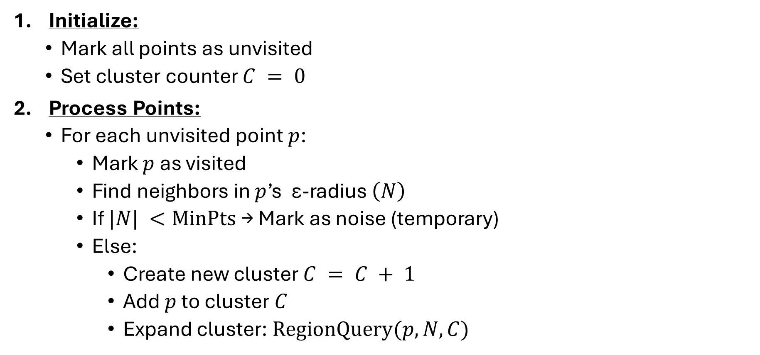
DBSCAN Steps
Initialize:
Mark all points as unvisited
Set cluster counter $C = 0$
Process Points:
For each unvisited point $p$:
Mark $p$ as visited
Find neighbors in $p$’s ε-radius $\left(N\right)$
If $|N| <MinPts$ → Mark as noise (temporary)
Else:
Create new cluster $C = C + 1$
Add $p$ to cluster $C$
Expand cluster: $RegionQuery(p, N, C)$

Slide 20
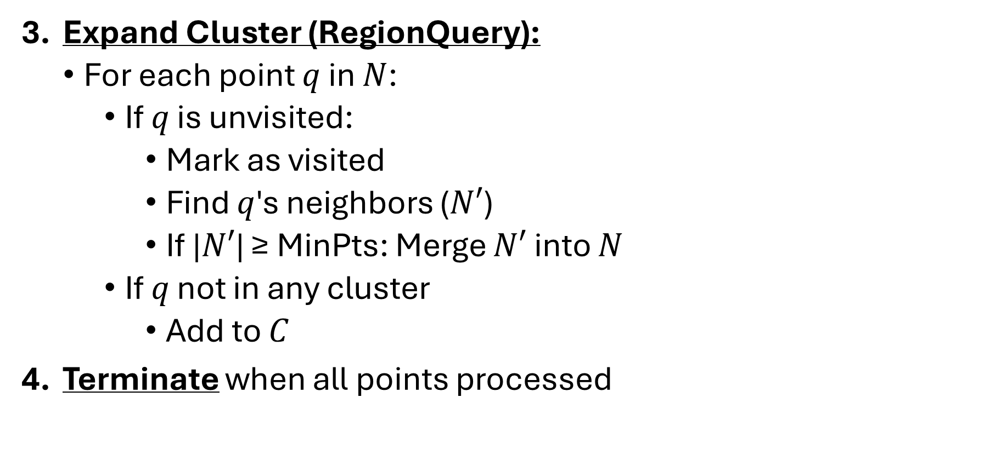
DBSCAN Steps (contd.)
Expand Cluster (RegionQuery):
For each point $q$ in $N$:
If $q$ is unvisited:
Mark as visited
Find $q$'s neighbors ($N′$)
If |$N′$| ≥ MinPts: Merge $N′$ into $N$
If $q$ not in any cluster
Add to $C$
Terminate when all points processed

Slide 21
DBSCAN: Example (𝜀=1.9, MinPts=4)
Dataset:
A(3, 7), B(4, 6), C(5, 5), D(6, 4), E(7, 3), F(6, 2), G(7, 2), H(8, 4), I(3, 3), J(2, 6), K(3, 5), L(2, 4)

Slide 22
DBSCAN: Example (𝜀=1.9) (contd.)
 | A | B | C | D | E | F | G | H | I | J | K | L
A | 0
B | 1.41 | 0
C | 2.83 | 1.41 | 0
D | 4.24 | 2.83 | 1.41 | 0
E | 5.66 | 4.24 | 2.83 | 1.41 | 0
F | 5.83 | 4.47 | 3.16 | 2.00 | 1.41 | 0
G | 6.40 | 5.00 | 3.61 | 2.24 | 1.00 | 1.00 | 0
H | 5.83 | 4.47 | 3.16 | 2.00 | 1.41 | 2.83 | 2.24 | 0
I | 4.00 | 3.16 | 2.83 | 3.16 | 4.00 | 3.16 | 4.12 | 5.10 | 0
J | 1.41 | 2.00 | 3.16 | 4.47 | 5.83 | 5.66 | 6.40 | 6.32 | 3.16 | 0
K | 2.00 | 1.41 | 2.00 | 3.16 | 4.47 | 4.24 | 5.00 | 5.10 | 2.00 | 1.41 | 0
L | 3.16 | 2.83 | 3.16 | 4.00 | 5.10 | 4.47 | 5.39 | 6.00 | 1.41 | 2.00 | 1.41 | 0

Slide 23
DBSCAN: Example (MinPts=4) (contd.)
 | Neighbors
A | B, J
B | A, C, K
C | B, D
D | C, E
E | D, F, G, H
F | E, G
G | E, F
H | E
I | L
J | A, K
K | B, J, L
L | I, K
 | Status
A | Noise → | Border (w.r.t B)
B | Core
C | Noise → | Border (w.r.t B)
D | Noise → | Border (w.r.t E)
E | Core
F | Noise → | Border (w.r.t E)
G | Noise → | Border (w.r.t E)
H | Noise → | Border (w.r.t E)
I | Noise → | Noise
J | Noise → | Border (w.r.t K)
K | Core
L | Noise → | Border (w.r.t K)

Slide 24
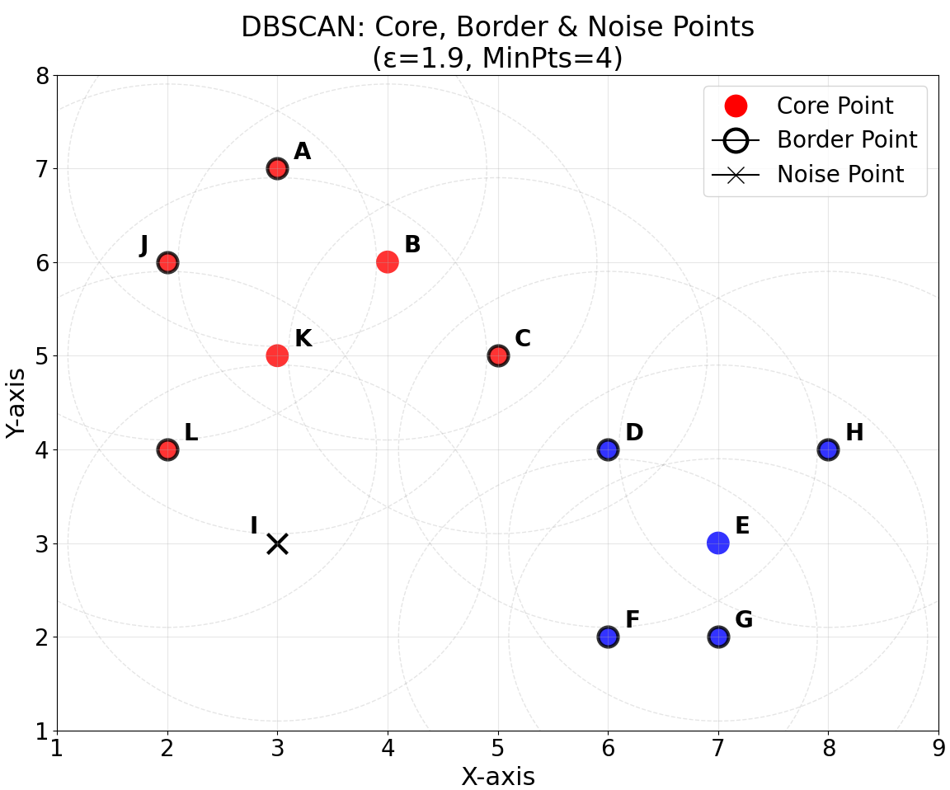
DBSCAN: Example (contd.)

Slide 25
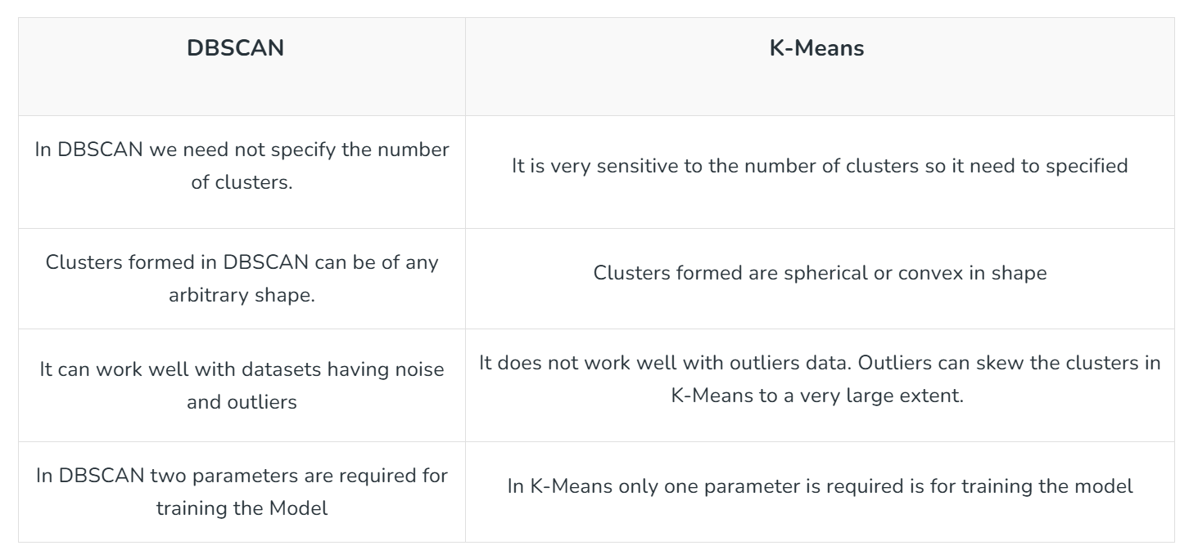
DBSCAN vs K-Means
Image credit: GeeksForGeeks

